Slide 1

Sai Srikar Lab-9

Slide 2

PANTONE® COLOUR OF THE YEAR 2022
If you pass cv.CHAIN_APPROX_NONE, all the boundary points are stored. But actually do we need all the points? For eg, you found the contour of a straight line. Do you need all the points on the line to represent that line? No, we need just two end points of that line. This is what cv.CHAIN_APPROX_SIMPLE does. It removes all redundant points and compresses the contour, thereby saving memory.
Below image of a rectangle demonstrate this technique. Just draw a circle on all the coordinates in the contour array (drawn in blue color). First image shows points I got with cv.CHAIN_APPROX_NONE (734 points) and second image shows the one with cv.CHAIN_APPROX_SIMPLE (only 4 points). See, how much memory it saves!!!

Slide 3
PANTONE® COLOUR OF THE YEAR 2022
import cv2
import matplotlib.pyplot as plt
image = cv2.imread('sunflower.jpeg')
cv2.imshow("Original Image",image)
cv2.waitKey(0)
cv2.destroyAllWindows()
image = cv2.copyMakeBorder(image, 10, 10, 10, 10, cv2.BORDER_CONSTANT, value=[255, 255, 255])
imgray = cv2.cvtColor(image, cv2.COLOR_BGR2GRAY)
imgray = cv2.GaussianBlur(imgray, (9, 9), 0)
ret, thresh = cv2.threshold(imgray, 0, 255, cv2.THRESH_BINARY_INV+cv2.THRESH_OTSU)
contours, hierarchy = cv2.findContours(thresh, cv2.RETR_TREE, cv2.CHAIN_APPROX_NONE)
img2=cv2.drawContours(image, contours, -1, (0, 255, 0), 3)
cv2.imshow("Chain Aprrox NONE",img2)
cv2.waitKey(0)
cv2.destroyAllWindows()

Slide 4

PANTONE® COLOUR OF THE YEAR 2022
OUTPUT-:

Slide 5
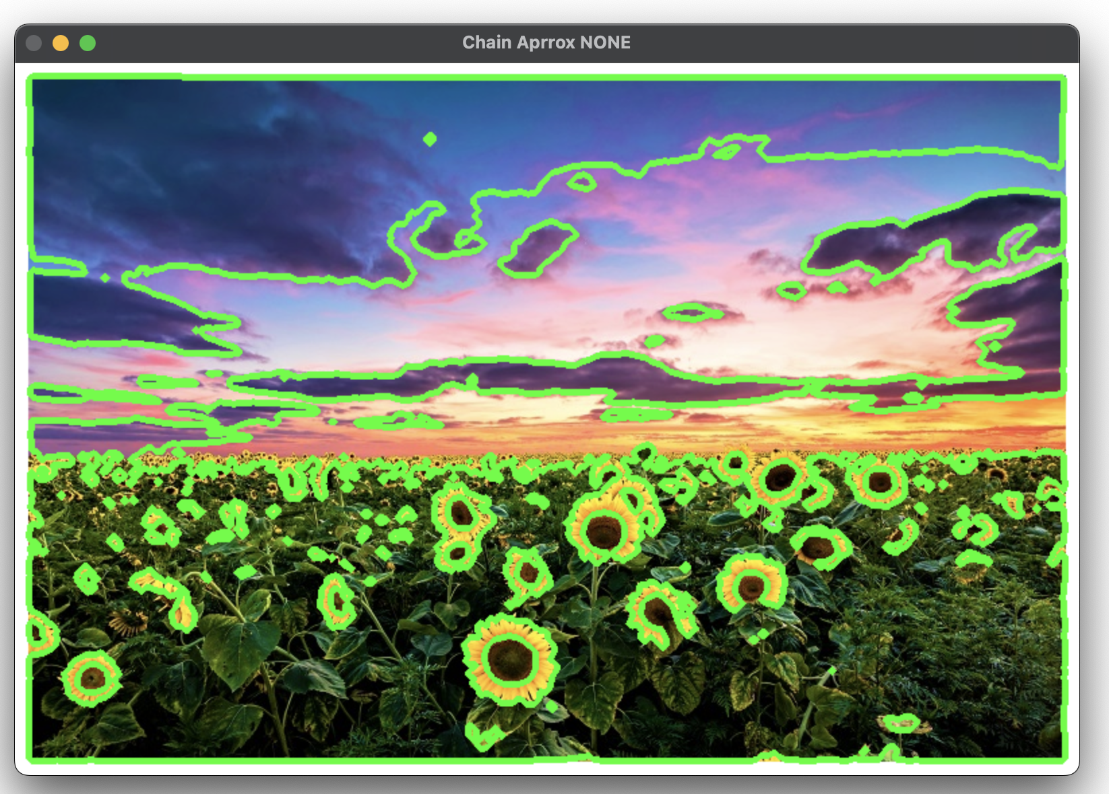
PANTONE® COLOUR OF THE YEAR 2022
OUTPUT-:

Slide 6
import cv2
import matplotlib.pyplot as plt
image = cv2.imread('picture.jpg')
cv2.imshow("Original Image",image)
cv2.waitKey(0)
cv2.destroyAllWindows()
#padding since the t-shirt is touching the border, without this we cant get a continious contour around it.
image = cv2.copyMakeBorder(image, 10, 10, 10, 10, cv2.BORDER_CONSTANT, value=[255, 255, 255])
imgray = cv2.cvtColor(image, cv2.COLOR_BGR2GRAY)
imgray = cv2.GaussianBlur(imgray, (9, 9), 0)
ret, thresh = cv2.threshold(imgray, 0, 255, cv2.THRESH_BINARY_INV+cv2.THRESH_OTSU)
contours, hierarchy = cv2.findContours(thresh, cv2.RETR_TREE, cv2.CHAIN_APPROX_SIMPLE)
img2=cv2.drawContours(image, contours, -1, (0, 255, 0), 3)
cv2.imshow("Chain Aprrox Simple",img2)
cv2.waitKey(0)
cv2.destroyAllWindows()

Slide 7
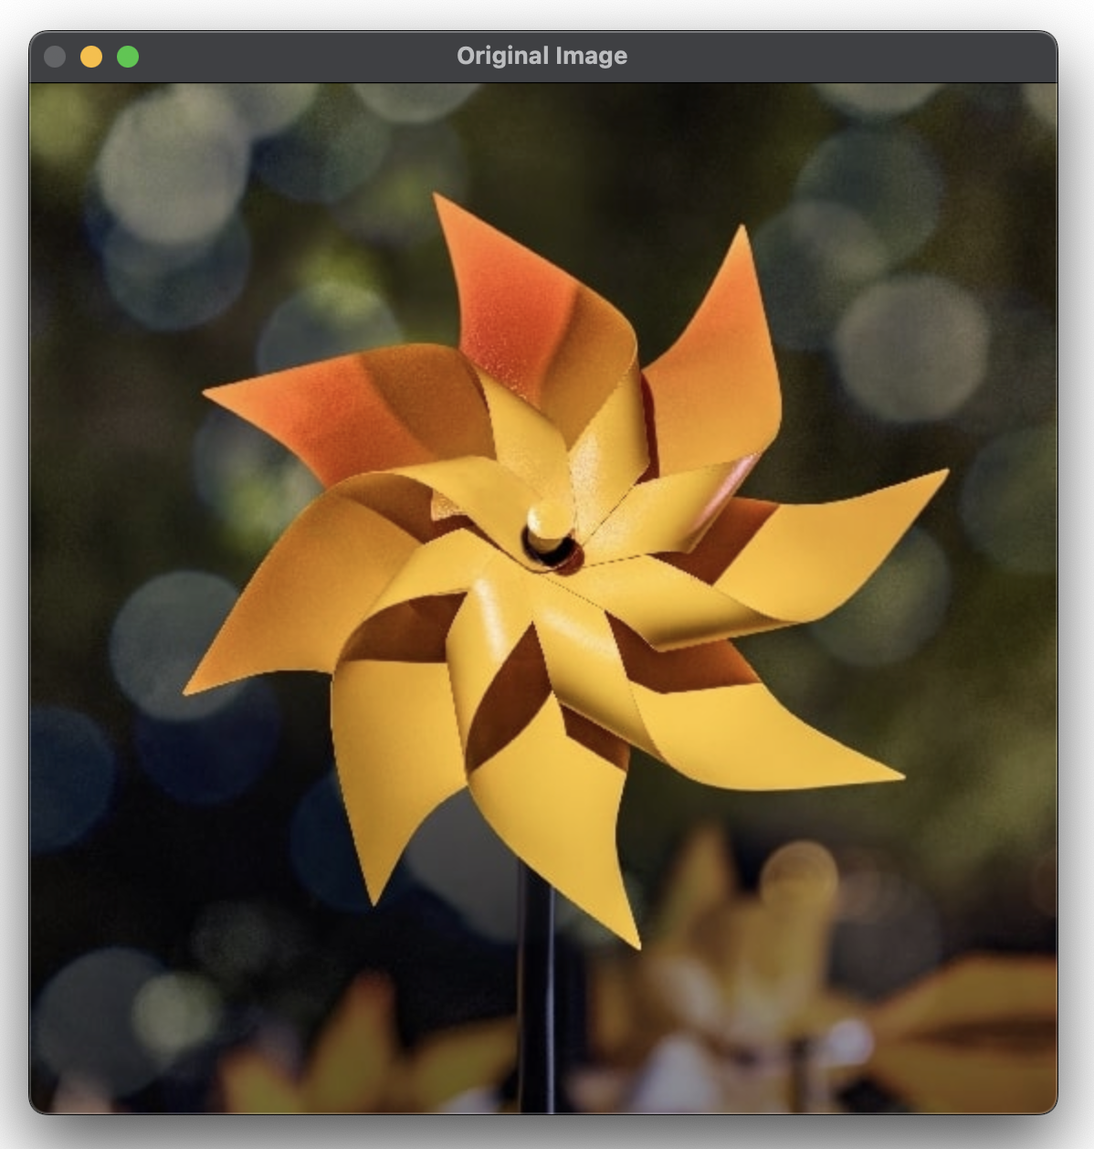
PANTONE® COLOUR OF THE YEAR 2022
OUTPUT-:

Slide 8
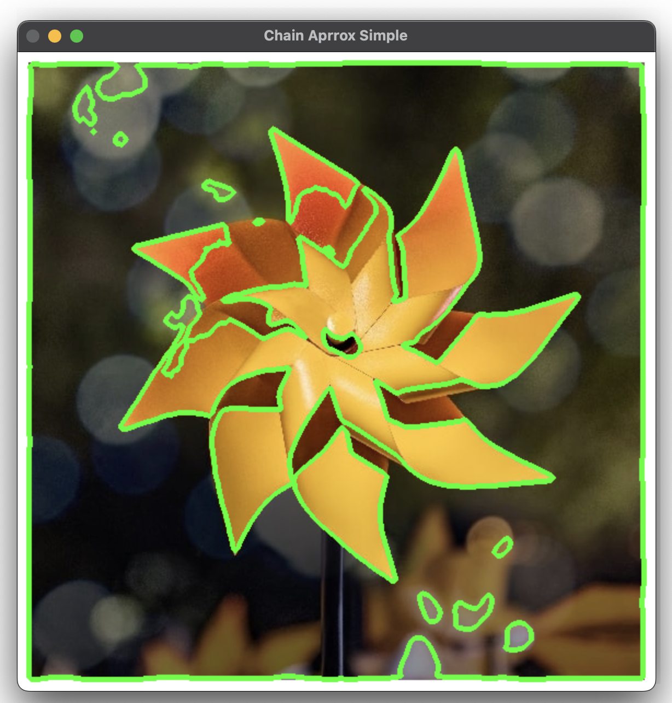
PANTONE® COLOUR OF THE YEAR 2022
OUTPUT-:

Slide 9
PANTONE® COLOUR OF THE YEAR 2022
import numpy as np
import cv2
img = cv2.imread('parrot.webp')
cv2.imshow('Original Image', img)
cv2.waitKey(0)
#g i.e green parts
hsv = cv2.cvtColor(img, cv2.COLOR_BGR2HSV)
lower = np.array([40, 0, 55])
upper = np.array([100, 255, 255])
mask = cv2.inRange(hsv, lower, upper)
result = cv2.bitwise_and(img, img, mask=mask)
cv2.imshow('result', result)
cv2.waitKey(0)
image = result.copy()
new_image = image.copy()
gray = cv2.cvtColor(image, cv2.COLOR_BGR2GRAY)

Slide 10
PANTONE® COLOUR OF THE YEAR 2022
cv2.imshow('Gray image', gray)
cv2.waitKey(0)
cv2.destroyAllWindows()
# Convert the grayscale image to binary
ret, binary = cv2.threshold(gray, 100, 255, cv2.THRESH_OTSU)
cv2.imshow('Binary image', binary)
cv2.waitKey(0)
cv2.destroyAllWindows()
# To detect object contours, we want a black background and a white
# foreground, so we invert the image (i.e. 255 - pixel value)
inverted_binary = ~binary
cv2.imshow('Inverted binary image', inverted_binary)
cv2.waitKey(0)
cv2.destroyAllWindows()
# Find the contours on the inverted binary image, and store them in a list
# Contours are drawn around white blobs.
# hierarchy variable contains info on the relationship

Slide 11
PANTONE® COLOUR OF THE YEAR 2022
between the contours
contours, hierarchy = cv2.findContours(inverted_binary,cv2.RETR_TREE,cv2.CHAIN_APPROX_SIMPLE)
# Draw the contours (in red) on the original image and display the result
# Input color code is in BGR (blue, green, red) format
# -1 means to draw all contours
with_contours = cv2.drawContours(image, contours, -1,(255,0,255),3)
cv2.imshow('Detected contours', with_contours)
cv2.waitKey(0)
cv2.destroyAllWindows()
#for b i.e blue
hsv = cv2.cvtColor(img, cv2.COLOR_BGR2HSV)
lower = np.array([110,50,50])
upper= np.array([130,255,255])
mask = cv2.inRange(hsv, lower, upper)
result = cv2.bitwise_and(img, img, mask=mask)
cv2.imshow('result', result)
cv2.waitKey(0)

Slide 12
PANTONE® COLOUR OF THE YEAR 2022
image = result.copy()
new_image = image.copy()
gray = cv2.cvtColor(image, cv2.COLOR_BGR2GRAY)
cv2.imshow('Gray image', gray)
cv2.waitKey(0)
cv2.destroyAllWindows()
# Convert the grayscale image to binary
ret, binary = cv2.threshold(gray, 100, 255, cv2.THRESH_OTSU)
cv2.imshow('Binary image', binary)
cv2.waitKey(0)
cv2.destroyAllWindows()
# To detect object contours, we want a black background and a white
# foreground, so we invert the image (i.e. 255 - pixel value)
inverted_binary = ~binary
cv2.imshow('Inverted binary image', inverted_binary)
cv2.waitKey(0)
cv2.destroyAllWindows()
# Find the contours on the inverted binary image, and store them in a list

Slide 13
PANTONE® COLOUR OF THE YEAR 2022
# Contours are drawn around white blobs.
# hierarchy variable contains info on the relationship between the contours
contours, hierarchy = cv2.findContours(inverted_binary,cv2.RETR_TREE,cv2.CHAIN_APPROX_SIMPLE)
# Draw the contours (in red) on the original image and display the result
# Input color code is in BGR (blue, green, red) format
# -1 means to draw all contours
with_contours = cv2.drawContours(image, contours, -1,(255,0,255),3)
cv2.imshow('Detected contours', with_contours)
cv2.waitKey(0)
cv2.destroyAllWindows()
image = result.copy()
new_image = image.copy()
gray = cv2.cvtColor(image, cv2.COLOR_BGR2GRAY)
cv2.imshow('Gray image', gray)
cv2.waitKey(0)
cv2.destroyAllWindows()

Slide 14
PANTONE® COLOUR OF THE YEAR 2022
# Convert the grayscale image to binary
ret, binary = cv2.threshold(gray, 100, 255, cv2.THRESH_OTSU)
cv2.imshow('Binary image', binary)
cv2.waitKey(0)
cv2.destroyAllWindows()
# To detect object contours, we want a black background and a white
# foreground, so we invert the image (i.e. 255 - pixel value)
inverted_binary = ~binary
cv2.imshow('Inverted binary image', inverted_binary)
cv2.waitKey(0)
cv2.destroyAllWindows()
# Find the contours on the inverted binary image, and store them in a list
# Contours are drawn around white blobs.
# hierarchy variable contains info on the relationship between the contours
contours, hierarchy = cv2.findContours(inverted_binary,cv2.RETR_TREE,cv2.CHAIN_APPROX_SIMPLE)
# Draw the contours (in red) on the original image and display the result
# Input color code is in BGR (blue, green, red) format
# -1 means to draw all contours
with_contours = cv2.drawContours(image, contours, -1,(255,0,255),3)
cv2.imshow('Detected contours', with_contours)
cv2.waitKey(0)
cv2.destroyAllWindows()

Slide 15
PANTONE® COLOUR OF THE YEAR 2022
#for r i.e red
hsv = cv2.cvtColor(img, cv2.COLOR_BGR2HSV)
lower = np.array([0,50,50])
upper= np.array([30,255,255])
mask = cv2.inRange(hsv, lower, upper)
result = cv2.bitwise_and(img, img, mask=mask)
cv2.imshow('result', result)
cv2.waitKey(0)
image = result.copy()
new_image = image.copy()
gray = cv2.cvtColor(image, cv2.COLOR_BGR2GRAY)
cv2.imshow('Gray image', gray)
cv2.waitKey(0)
cv2.destroyAllWindows()
# Convert the grayscale image to binary
ret, binary = cv2.threshold(gray, 100, 255, cv2.THRESH_OTSU)
cv2.imshow('Binary image', binary)
cv2.waitKey(0)
cv2.destroyAllWindows()

Slide 16
PANTONE® COLOUR OF THE YEAR 2022
# To detect object contours, we want a black background and a white
# foreground, so we invert the image (i.e. 255 - pixel value)
inverted_binary = ~binary
cv2.imshow('Inverted binary image', inverted_binary)
cv2.waitKey(0)
cv2.destroyAllWindows()
# Find the contours on the inverted binary image, and store them in a list
# Contours are drawn around white blobs.
# hierarchy variable contains info on the relationship between the contours
contours, hierarchy = cv2.findContours(inverted_binary,cv2.RETR_TREE,cv2.CHAIN_APPROX_SIMPLE)
# Draw the contours (in red) on the original image and display the result
# Input color code is in BGR (blue, green, red) format
# -1 means to draw all contours
with_contours = cv2.drawContours(image, contours, -1,(255,0,255),3)
cv2.imshow('Detected contours', with_contours)
cv2.waitKey(0)
cv2.destroyAllWindows()

Slide 17
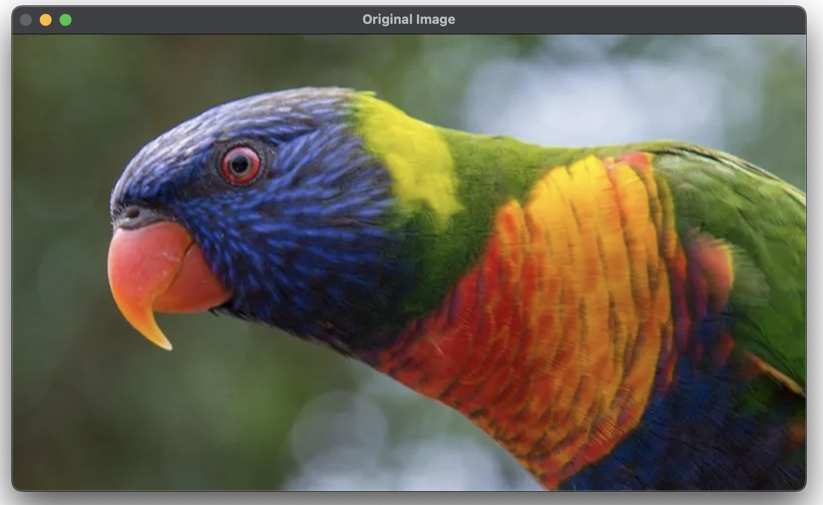
OUTPUT-:

Slide 18
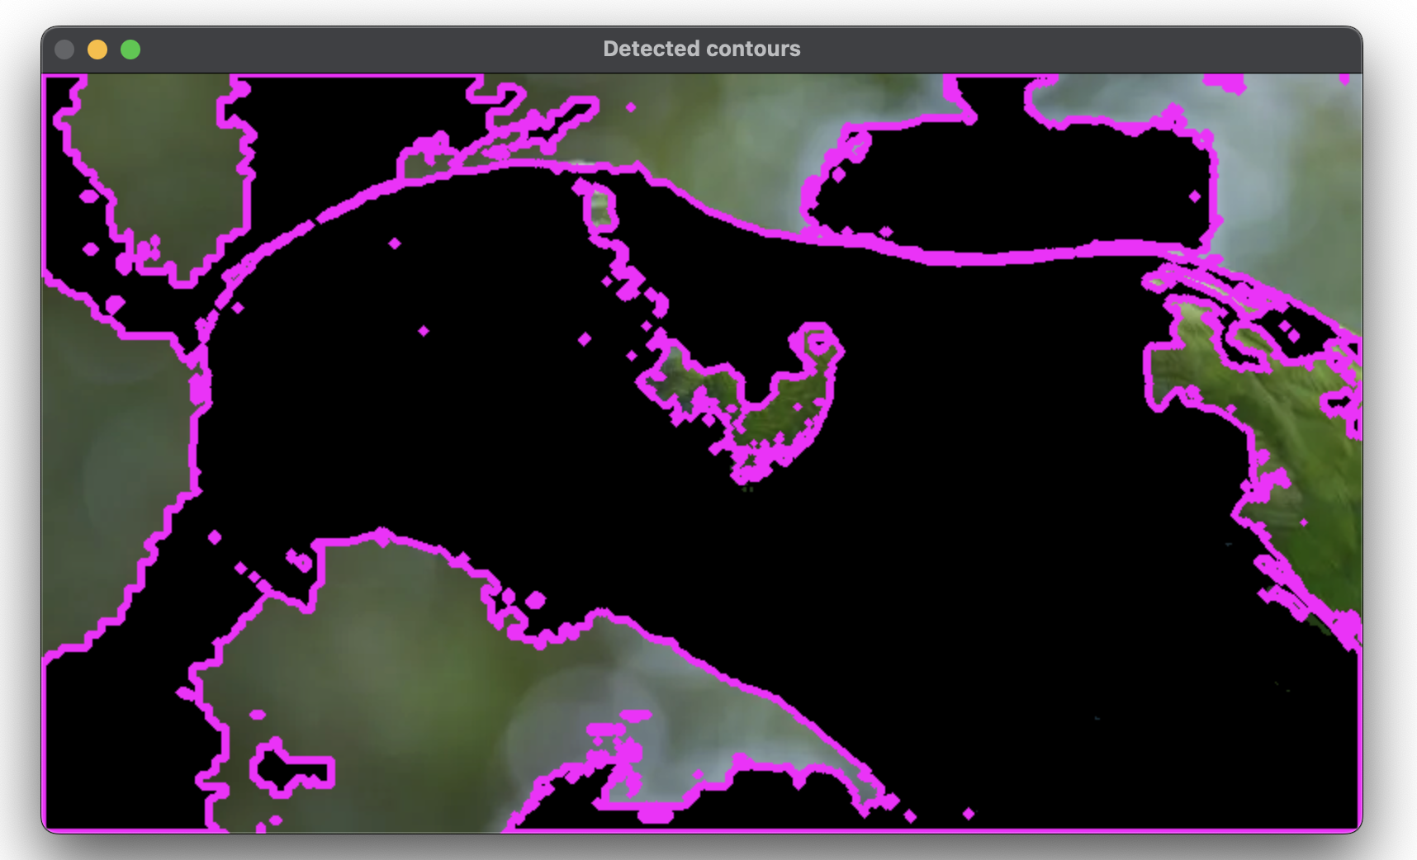
OUTPUT-:

Slide 19
OUTPUT-:

Slide 20
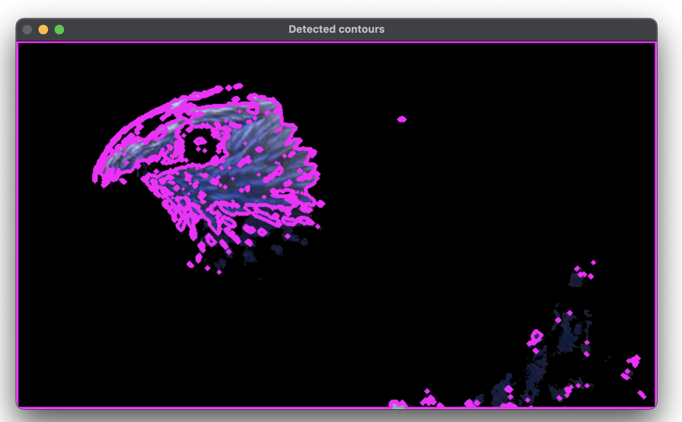
OUTPUT-:

Slide 21
OUTPUT-:

Slide 22
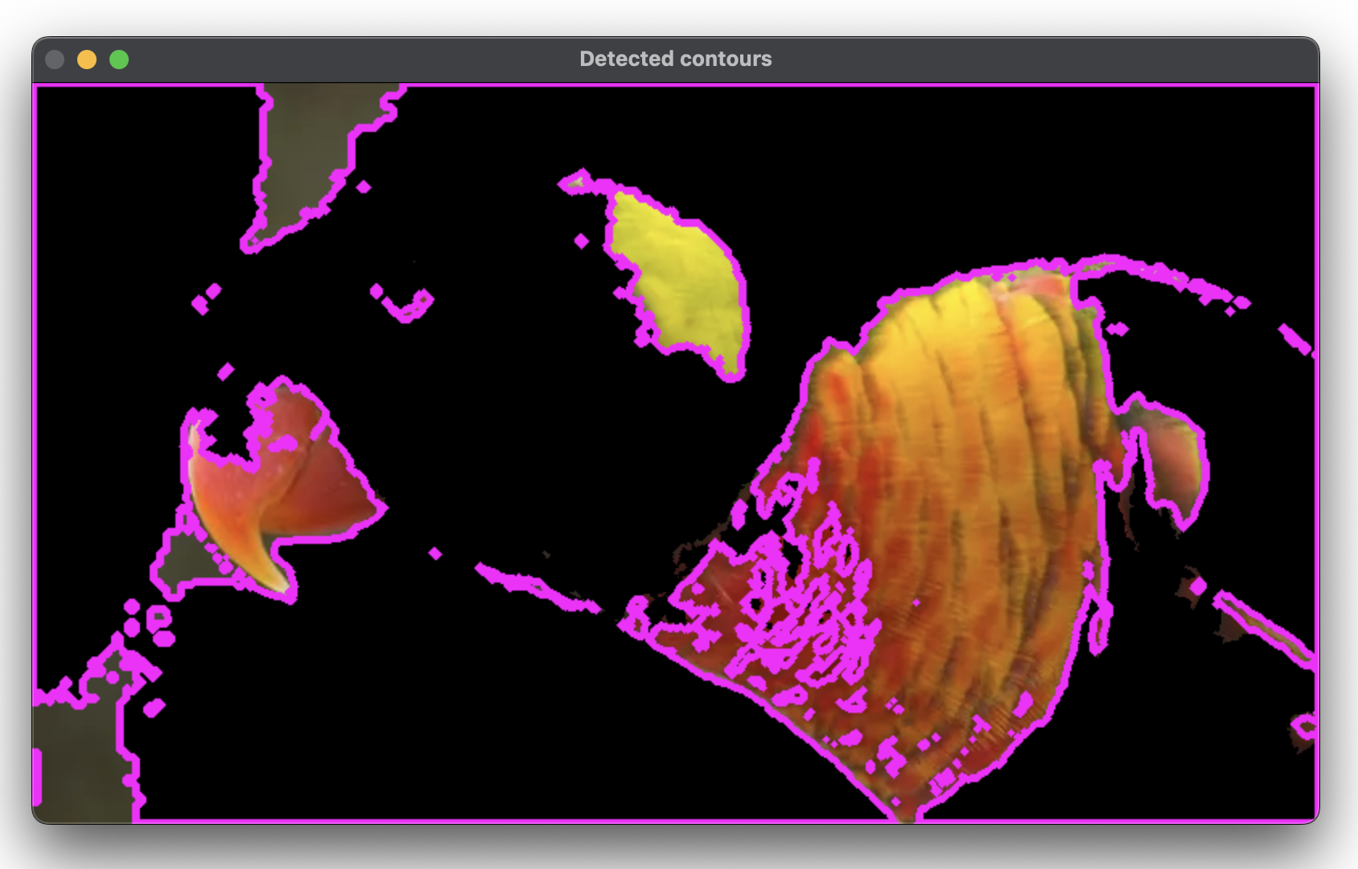
OUTPUT-:

Slide 23
THANK YOU You can find the code at -: https://github.com/Baka-14/Digital_Image_processing

